Slide 1
Master ASL Unit 1
Greetings
and
Responses

Slide 2

Meet the Characters (pg. 3)
Become familiar with their faces.
You will be seeing them through out the year in our book.
Introduction

Slide 3
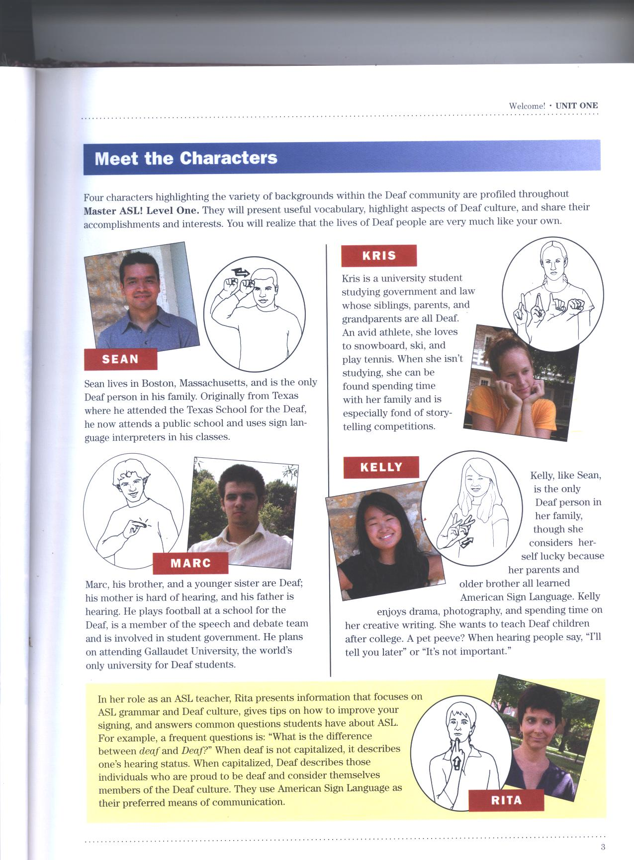
The boys…
What do you think they are showing you in the drawn pictures?

Slide 4
The girls…

Slide 5
The “teacher”

Slide 6
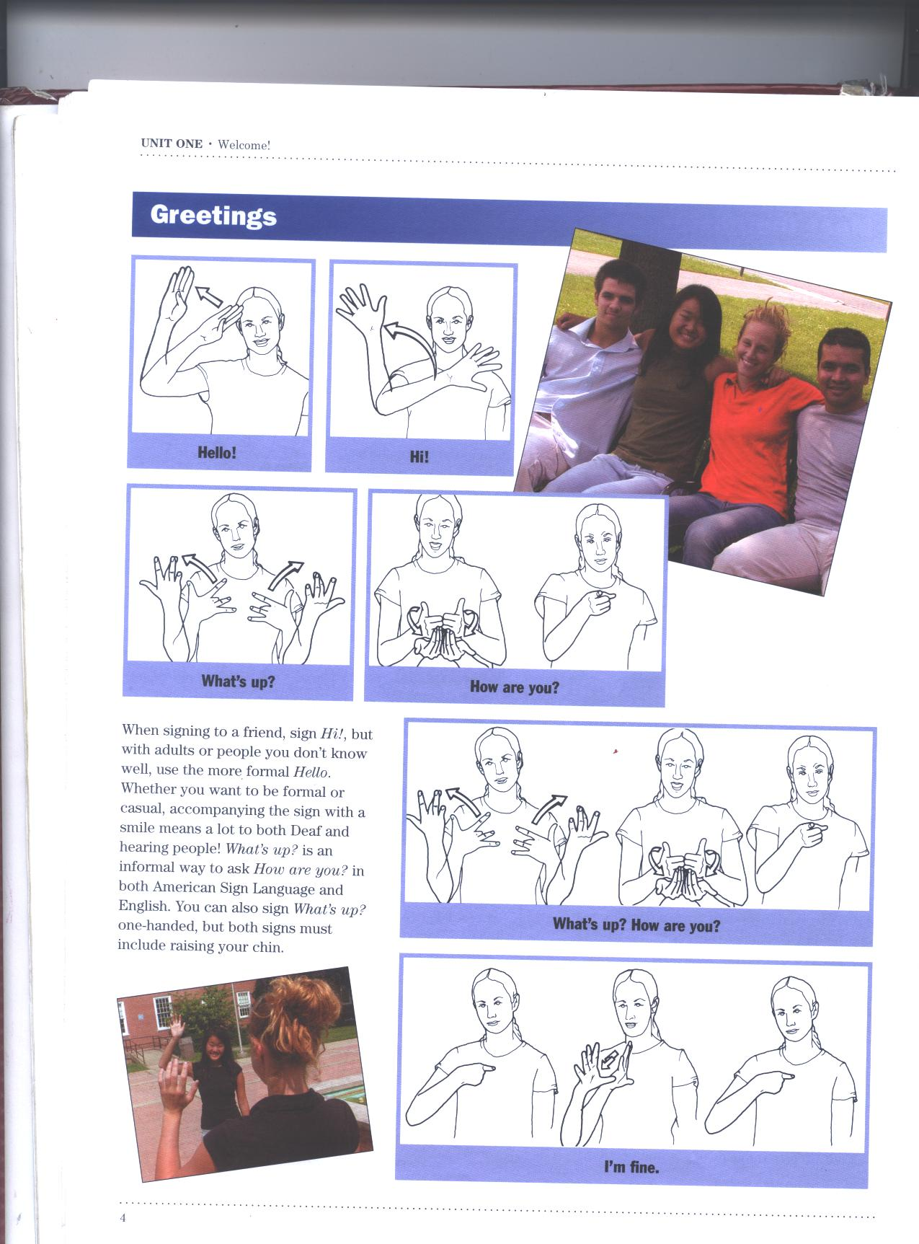
GREETINGS…
More formal…
Less formal…

Slide 7
GREETINGS!
Informal: (signing to a friend or someone very familiar)
  HI
  WHAT’S UP
Formal: (signing to an adult or new aquaintance)
  HELLO
  HOW ARE YOU?

Slide 8
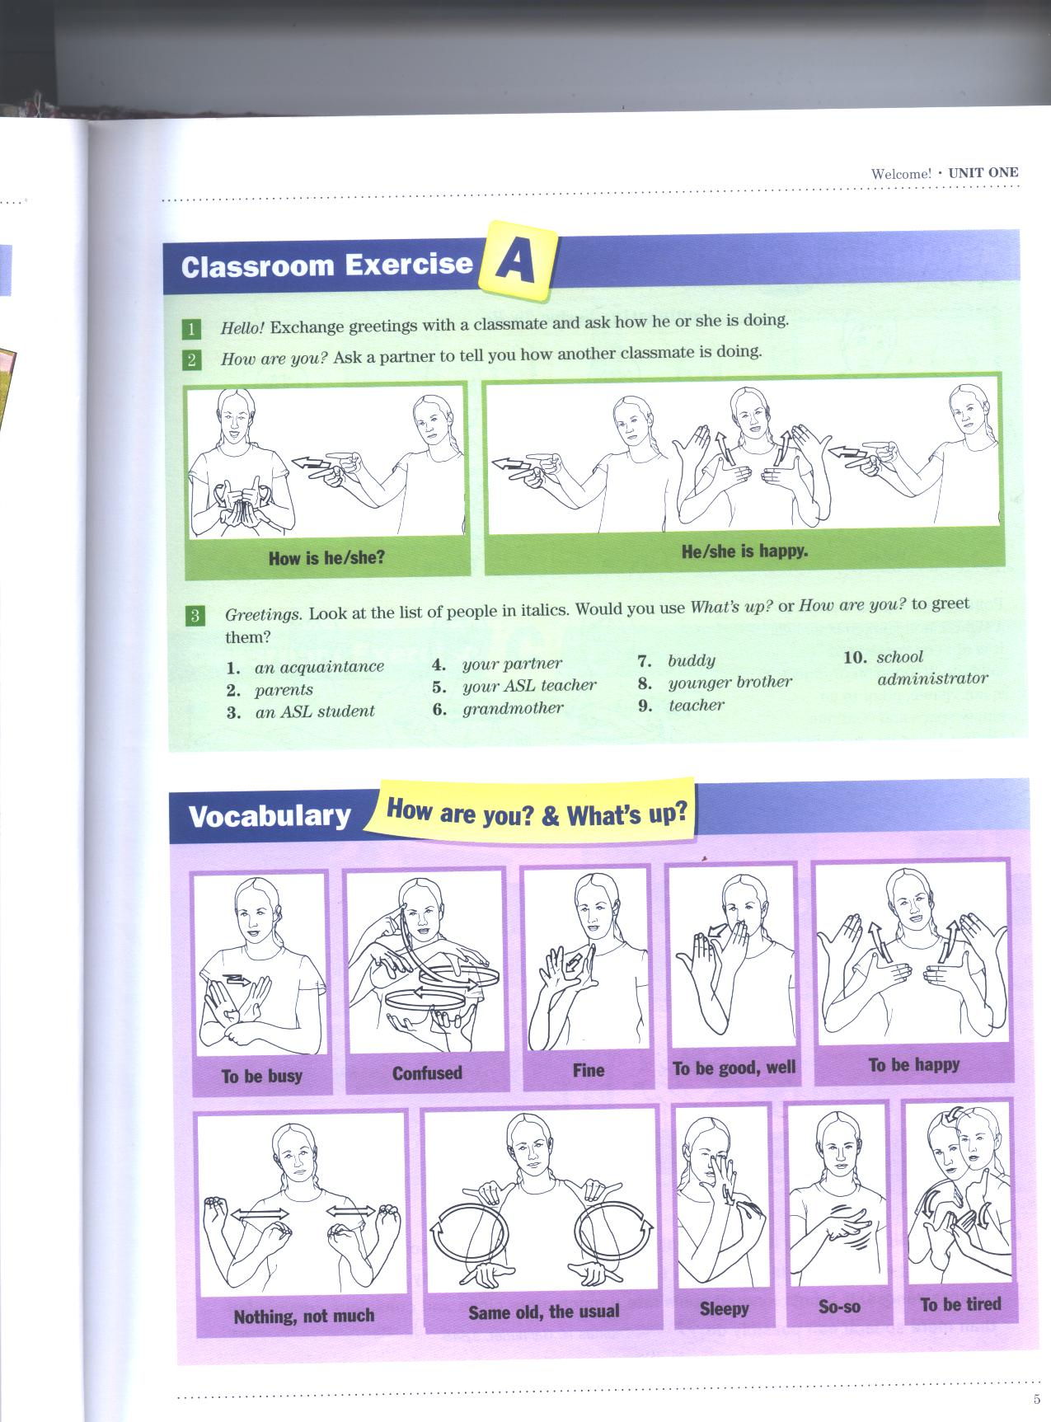

Slide 9
“How are you?”& “What’s Up” Vocabulary (pg. 5)
BUSY
CONFUSED
FINE
(To be) GOOD, WELL
HAPPY
NOTHING, NOT-MUCH
SAME-OLD, USUAL
SLEEPY
SO-SO
TIRED
It can all change with your facial expression.
Example: SAME-OLD

Slide 10
Practice with a partner…
When done, switch roles and sign it again.
Person #1
Person #2
1. Hello
3. Nothing much. How are you?
2. What’s up?
4. Good. (or any other response you would like to say.)

Slide 11
Would you use
“What’s Up?” or “How are you?”
Parents
Another ASL student
Your partner
Your ASL teacher or other teachers
Your boss at your first job
Buddy
Younger brother
School principle
An acquaintance

Slide 12
BEING verbs
Am, is, are, was, were
Being verbs are NOT USED in ASL.
Example:
I am 15 years old.
He is smart.

Slide 13

Deixis
(pronounced “dike – sis”)(pg. 6)
If a person or object is not visible, point to an empty space, or where they were last seen and continue signing.
Using the index finger to point is called DEXIS.
It implies the BEING VERB. (I am, We are, You are, He is, etc.…)
  I, me Ex. I am hungry. She is not hungry.
  You
  He, she, it
  We, us
  They
  You (plural)

Slide 14
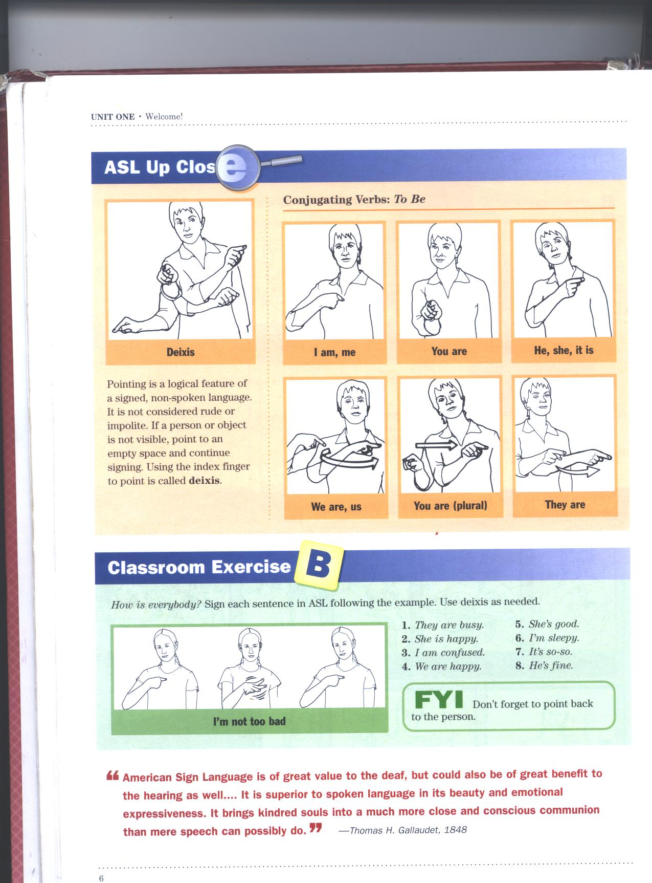

Slide 15
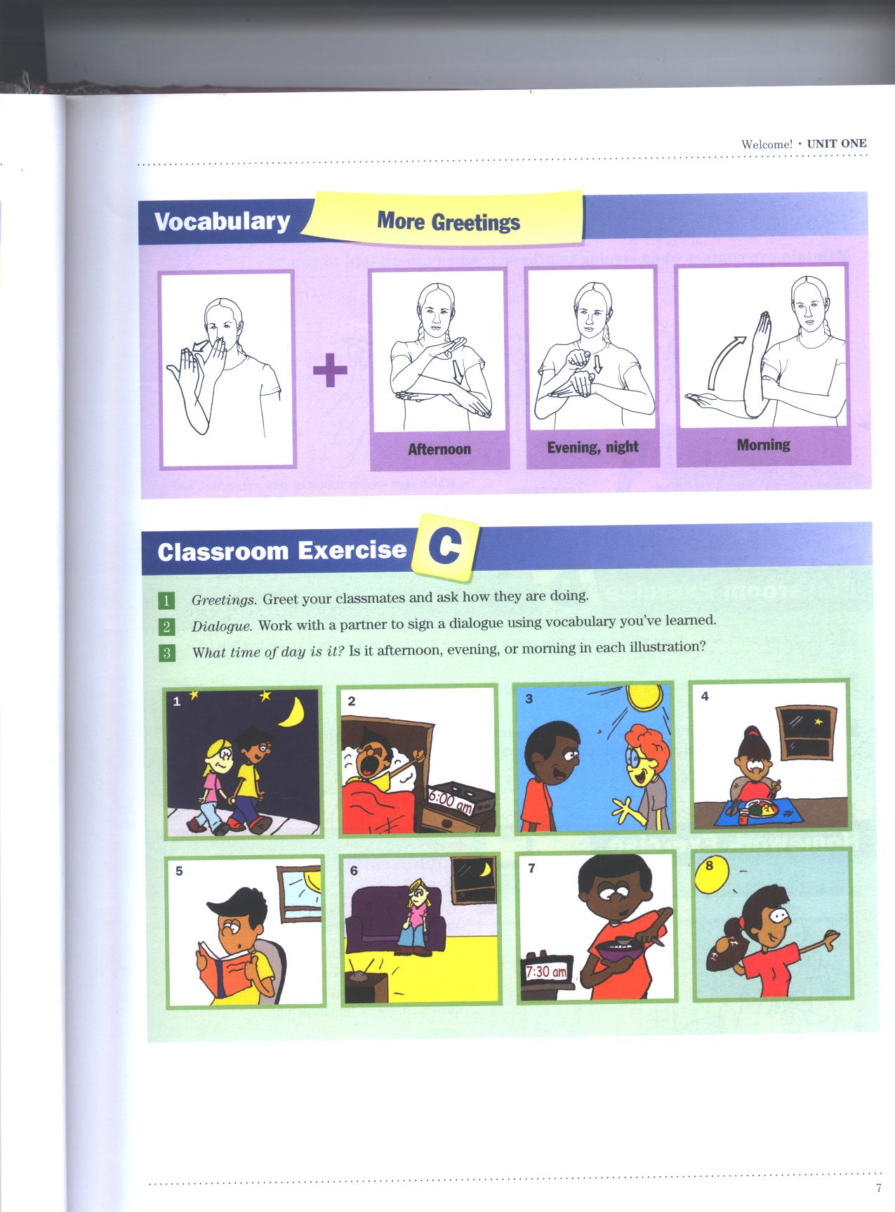
GOOD AFTERNOON EVENING/NIGHT MORNING
vs.
BAD

Slide 16
Vocabulary Review
Hello, Hi
What’s Up?
How are you?
Busy
Confused
Fine
Good
Happy
Nothing, not much
Same old, the usual
Sleepy
So-s0
Tired
Morning
Afternoon
Evening, night
Name

Slide 17
Review Continue
I, me
You
He, she, it
We, us
You (plural)
They

Slide 18
Introductions,
Making Conversation, Signing Good-bye

Slide 19

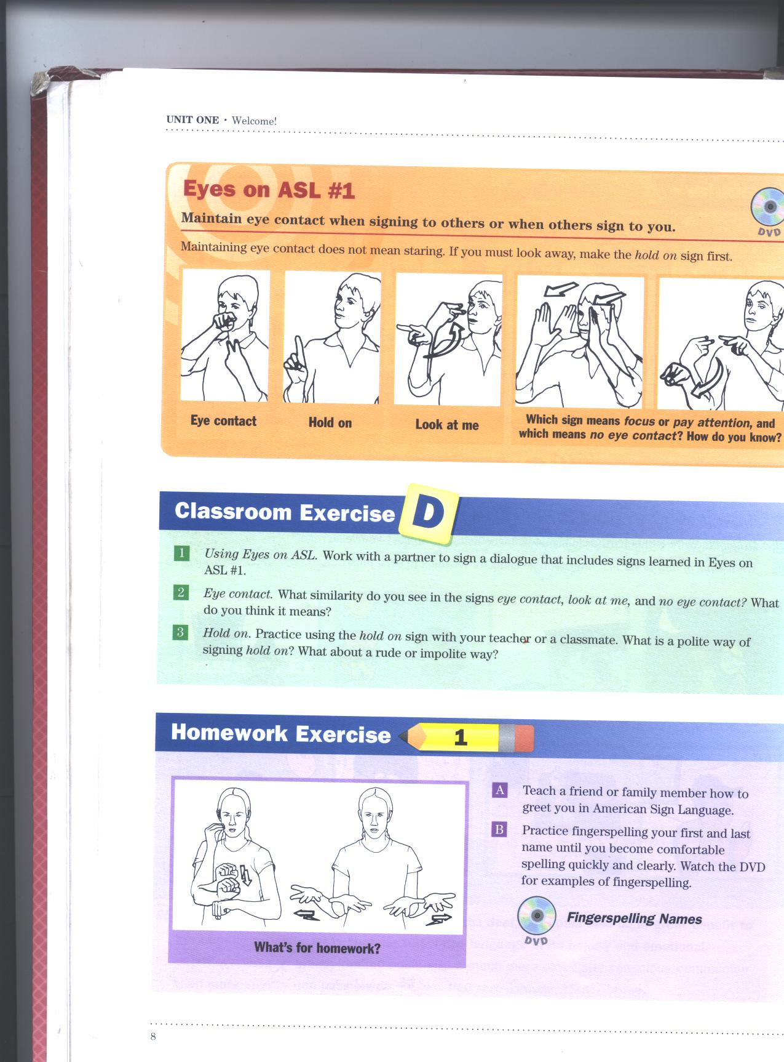
EYES ON ASL #1
Maintain eye contact when signing to others or when others sign to you. If you must look away, make the “hold on” sign first.

Slide 20
Why do I point Twice? Pg. 9
Pointing back to yourself or the person you’re talking about shows completion of train of thought. This allows somebody else to begin signing without interrupting you.
Using Deixis at the end of a sentence is called closing signal.
Remember to use a closing signal when:
  Making a statement or comment about yourself or somebody else.
  Asking a question
EYES ON ASL #2

Slide 21
Closing Signal
Putting diexis at the end of a sentence is called a closing signal.
Examples:
ME BUSY ME.
SHE TIRED SHE.

Slide 22
Introducing yourself
Hello, my name is….
HI ME NAME fs- ________________.
We don’t write or use IS because it is implied in the deixis.

Slide 23
Class Practice
English:
They are busy.
She is happy.
I am confused.
We are happy.
She’s good.
I’m sleepy.
ASL-GLOSS:
THEY BUSY THEY
SHE HAPPY SHE
ME CONFUSED ME
WE HAPPY WE
SHE GOOD SHE
ME SLEEPY ME

Slide 24
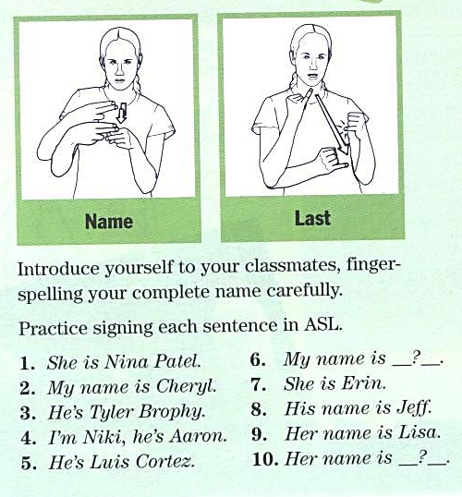
LET’S PRACTICE!

Slide 25
Deaf Culture Tid-bit
Introductions into the Deaf community tend to include both first and last names.
WHY?
You may know people in common.
The Deaf world can be very small.

Slide 26
Eyes on ASL #3
There is no such thing as a one word answer, or reply, in American Sign Language.
Detail is key!
  It’s better to have more information, than not enough.

Slide 27
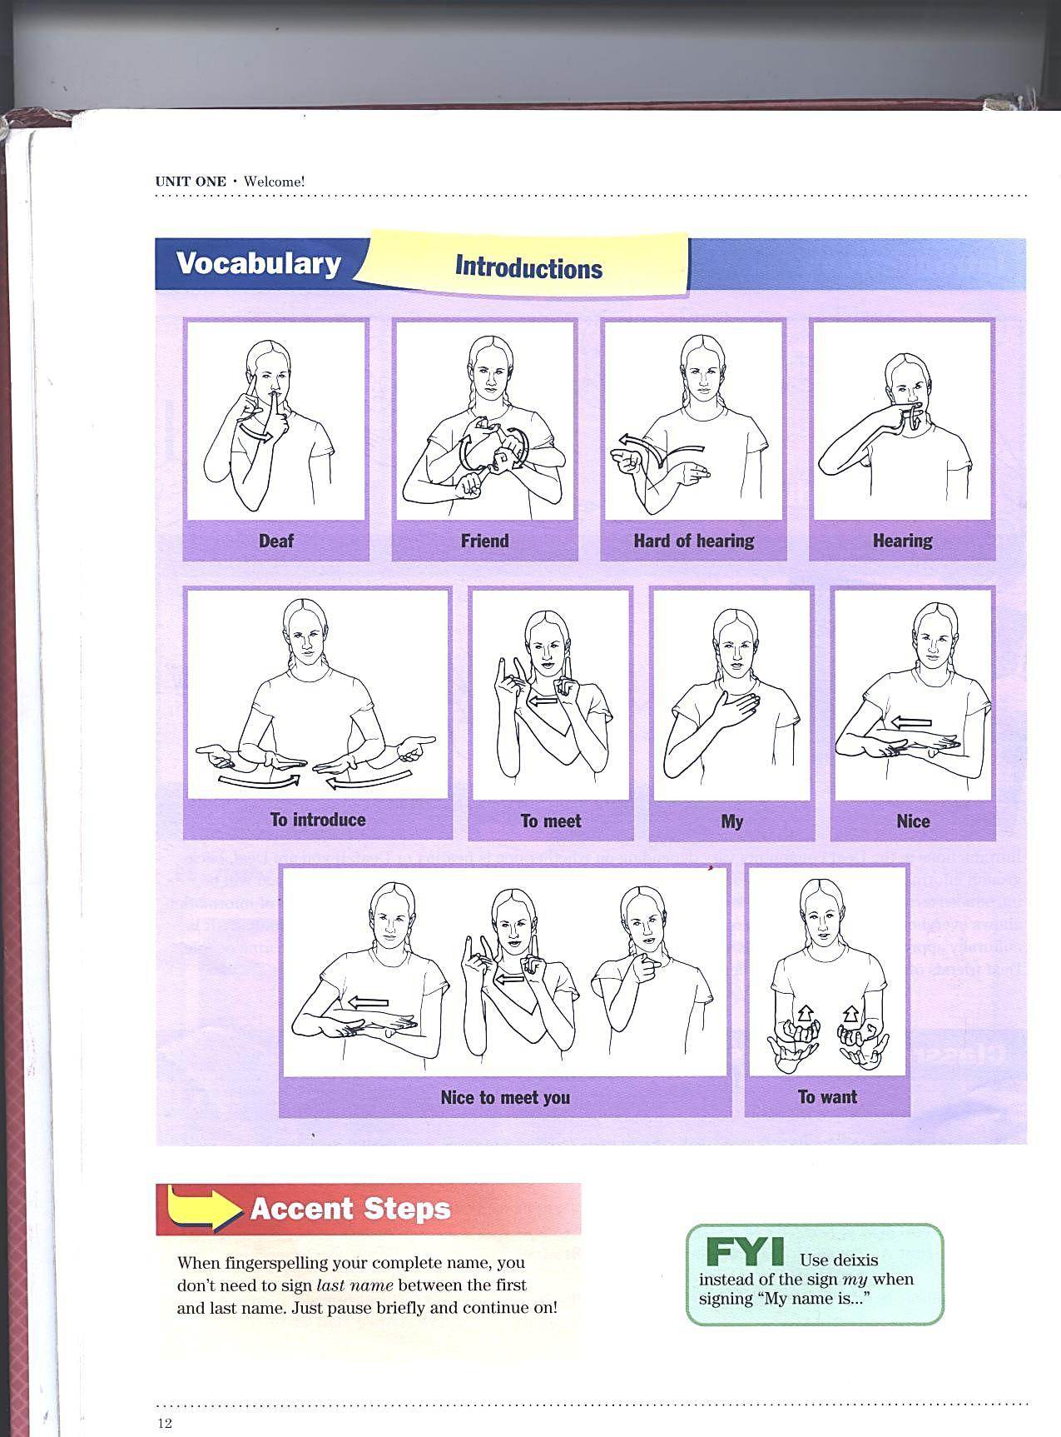

Slide 28
Introductions Vocabulary Pg. 12
DEAF
FRIEND
HARD-OF-HEARING
HEARING
INTRODUCE
MEET
MY
NICE
WANT
NAME

Slide 29
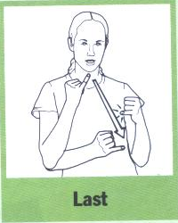

Accent Step page. 12
When fingerspelling your complete name, you don’t have to sign LAST NAME between the first and last name.
Just briefly pause and continue.
First Name
**pause**
Last name

Slide 30
Practice Sentences Pg. 9 & 11
English
ASL - GLOSS
What’s your name?
My name is Kelly Boyd.
I want to introduce my friend.
Her name is Lisa.
YOU NAME WHAT YOU
ME NAME fs- KELLY BOYD ME.
ME WANT INTRODUCE MY FRIEND.
SHE NAME L-I-S-A

Slide 31

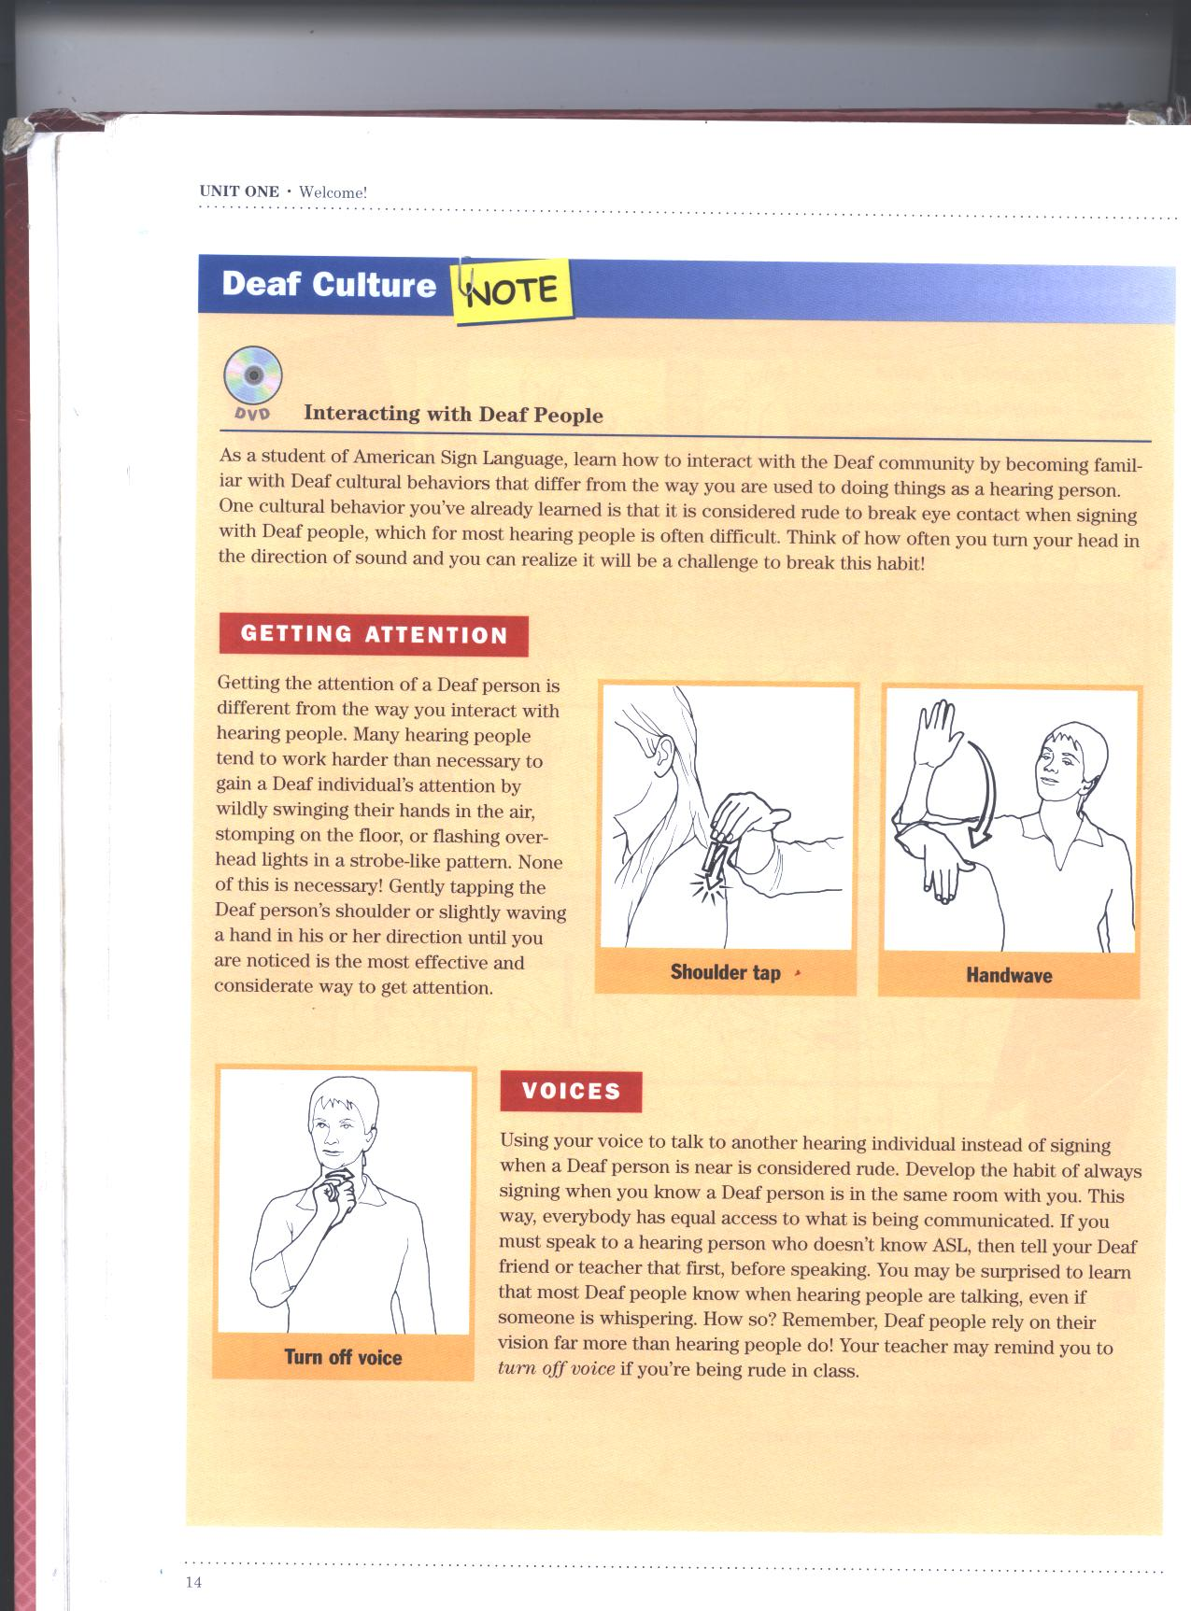
Interacting with Deaf People
Getting attention:
  Getting the attention of a Deaf person is different from getting attention of a hearing person.
  It doesn’t take much.

Slide 32
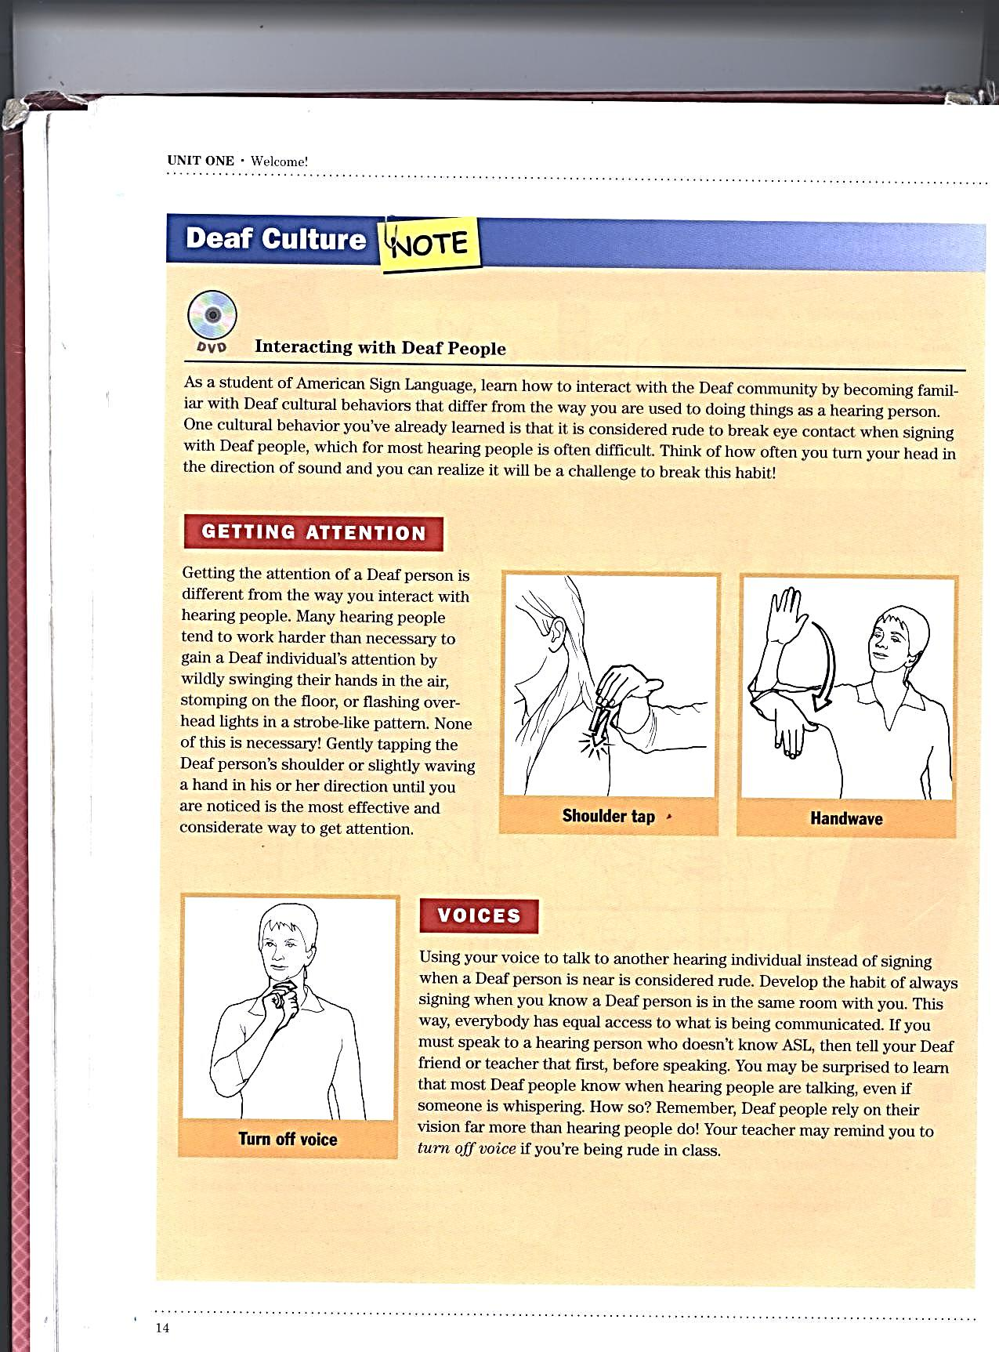
Interacting with Deaf People
Voices:
  If you know sign, & use your voice to talk to another person instead of signing when a Deaf person is near is considered rude.
  Develop habit of always signing when a Deaf person is in the room
  EQUAL ACCESS

Slide 33
Review- Introductions
DEAF
FRIEND
HARD-OF-HEARING
HEARING
INTRODUCE
MEET
MY
NICE
WANT
NAME

Slide 34
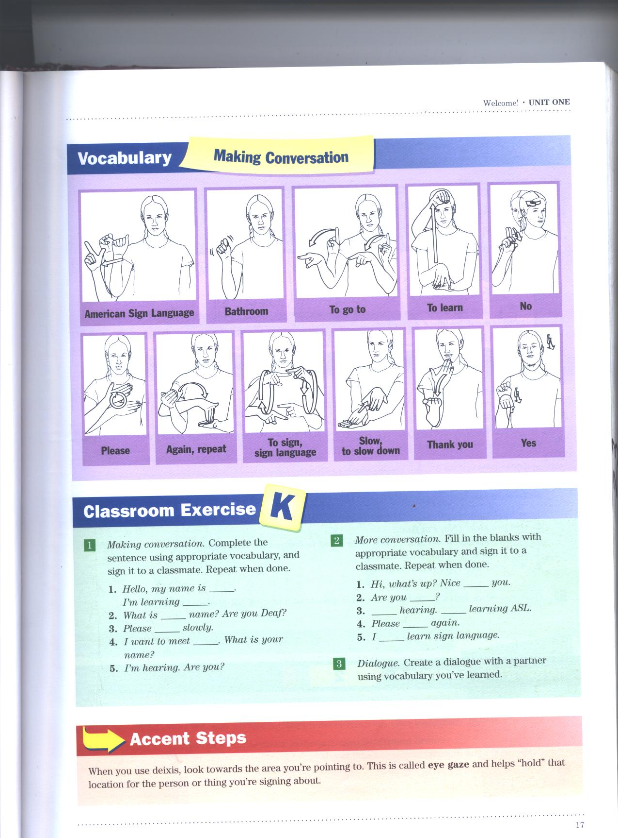

Slide 35
Making Conversation Pg. 17
American Sign Language
Bathroom
Go-to
Learn
To sign, sign language
Slow, to slow down
Yes
No
Please
Again, repeat
Thank you
Use sign language, to sign (alternate)

Slide 36
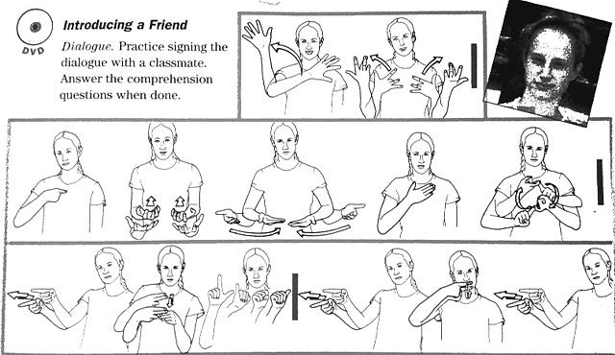
Introducing a friend… pg 13
See if you can break down the signs before we watch the video.

Slide 37
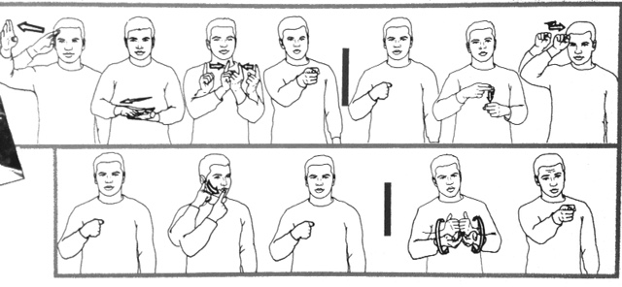

Slide 38
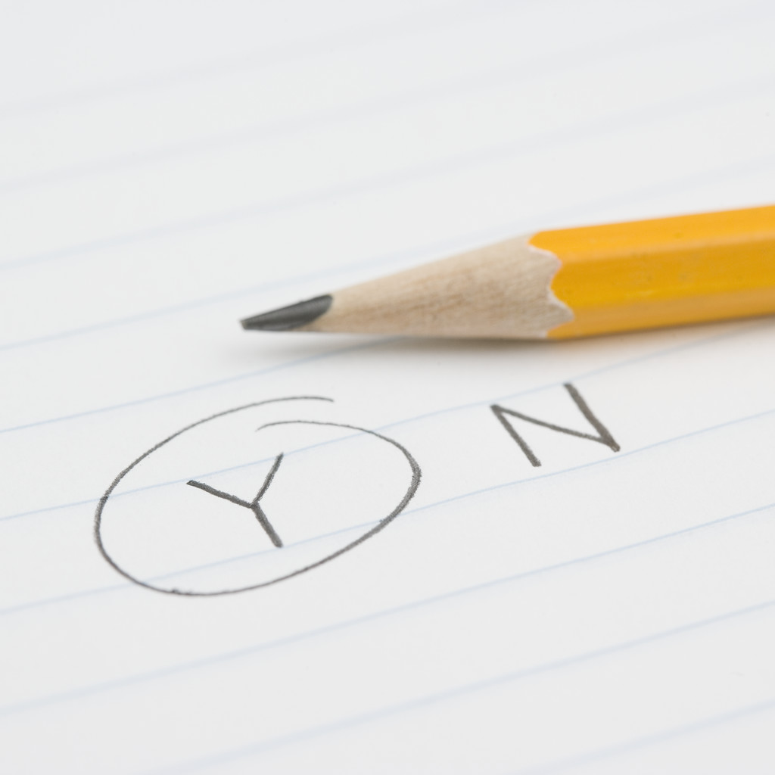
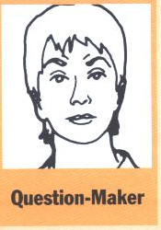

The Question Maker (pg. 15)
Raising your eyebrows forms the Question-Maker, an expression that shows your are asking a question.
Keep the eyebrows raised until you’ve completed signing the question.
Notice the difference the question maker makes to the example on page 15.
Raise your eyebrows!
YES or NO Questions…

Slide 39
Classroom Exercise J
Look on page 16 at numbers 1, 2, & 3.
  What are each of the sentences saying?
When finished read the “Accent Step” at the bottom of the page.
  Be prepared to talk about it. You never know who I will call on.

Slide 40
Accent Step (pg 17)
When you use deixis, look towards the area you’re pointing to. This is called EYE GAZE and helps “hold” that location for the person or thing you’re signing about.

Slide 41
Signs you should know for your quiz!
Eye contact
Hold on
Look at me
Pay attention
Deaf
Friend
Hard of hearing
Hearing
Introduce
Meet
My
Nice
Want
American Sign Language
Bathroom
To go to
To learn
Hi, hello
what’s up
busy
Confused
Fine
Good, well
Happy
Nothing, not much
Same old, the usual
Sleepy
So-so
Tired
Deixis
Yes
No
I am , me
You are
He, she, it is
We are, us
You are (plural)
They are
Eye contact
Please
Again, repeat
To sign, sign language
Slow, to slow down
Thank you
Afternoon
Evening, night
Morning

Slide 42
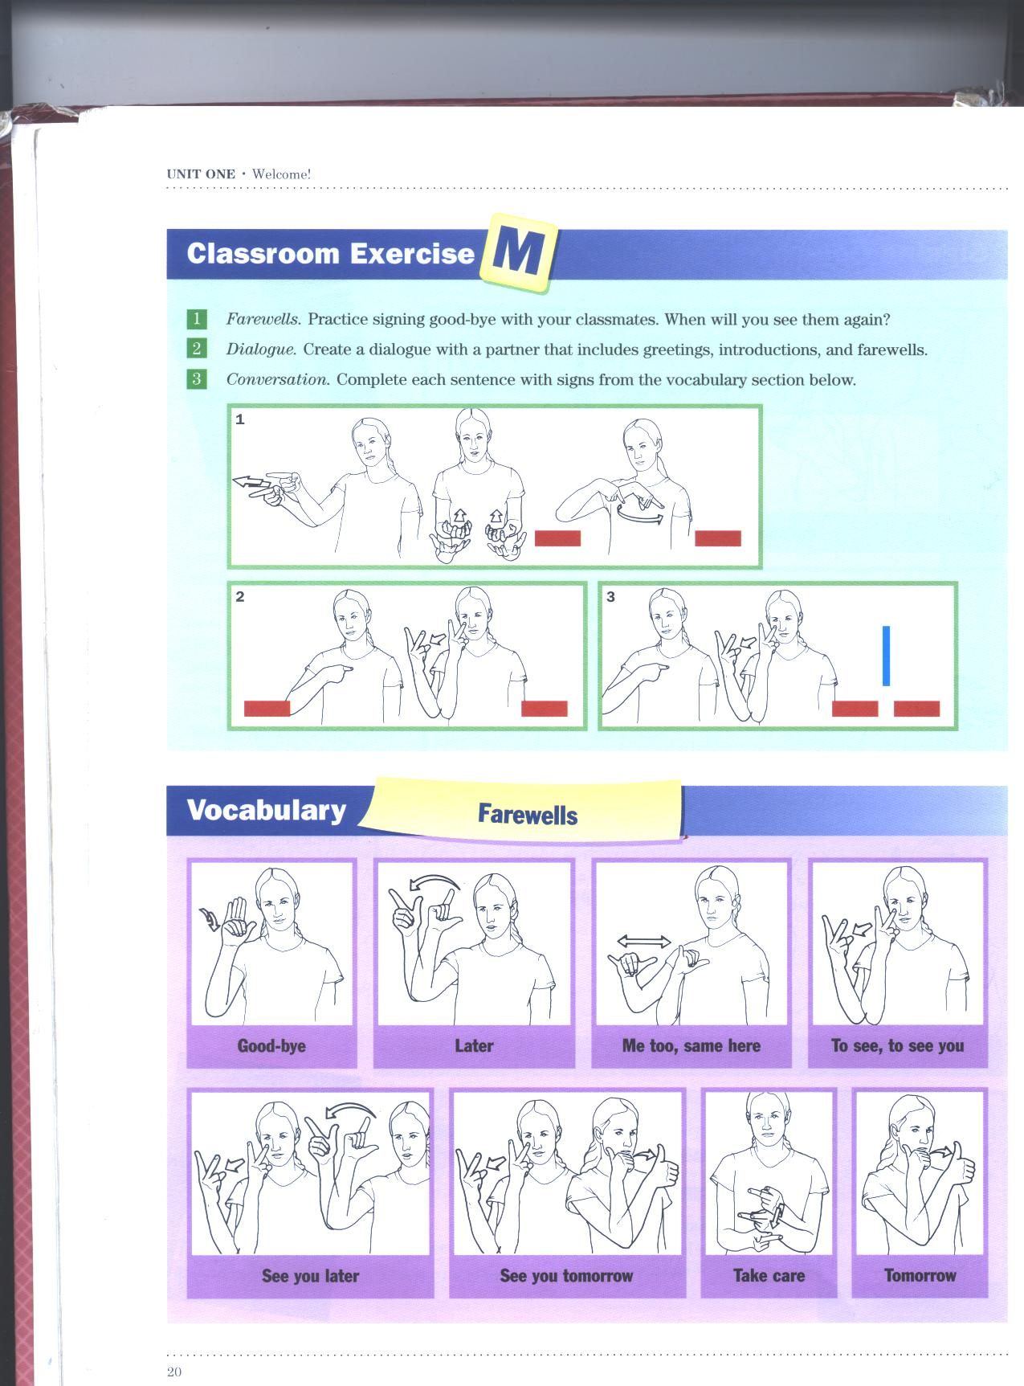

Slide 43
Accent Step (pg. 19)
Don’t add the separate sign for you when signing see you later or see you tomorrow.

Slide 44
Farewell Vocabulary Pg. 20
Good bye
Later
Me too, same here
See you, to see you
See you later
See you tomorrow
Take care
Tomorrow

Slide 45
Saying Good-bye Pg. 19
English
ASL - GLOSS
I’m happy to have met you!
Me too! I’ll see you tomorrow.
Yes, tomorrow morning. Take care!
Good-bye
ME HAPPY MEET YOU
SAME-AS ME SEE TOMORROW
YES TOMORROW MORNING TAKE CARE
GOOD-BYE

Slide 46
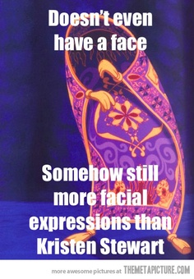
Facial Expressions
Page 25

Slide 47
Facial Expressions pg. 25
Conveys your tone of “voice” while you sign.
Without it, the sign is incomplete.
Your facial expressions should match the meaning and content of what you’re signing so if you’re singing I am happy then look happy! ☺
The sign can stay the same very time, but it means something different with a new facial expression.
  Look at the example on Page 25

Slide 48
Accent Step (pg 27)
It is normal to feel awkward or uncomfortable making facial expressions at first, but with practice you will become more confident and skilled. Without them you can’t sign questions, show interest, or carry on a satisfying conversation.
Think of learning facial expressions as a fun challenge!

Slide 49
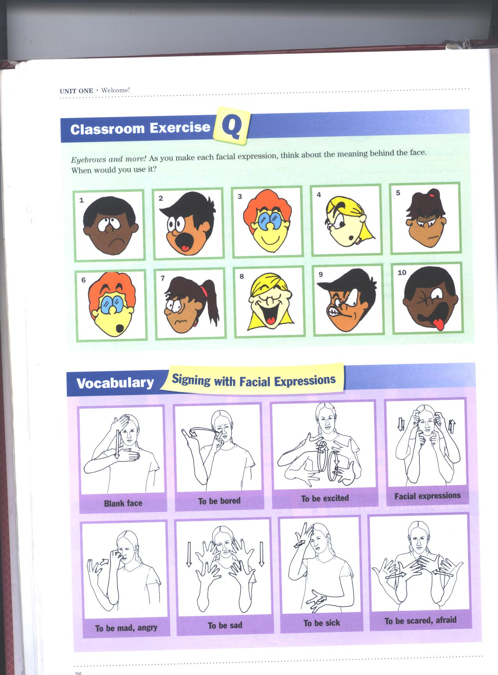

Slide 50
Signing with Facial Expressions pg. 26
BLANK FACE
BORED
EXCITED
FACIAL EXPRESSIONS
MAD, ANGRY
SAD
SICK, ILL
SCARED, AFRAID

Slide 51
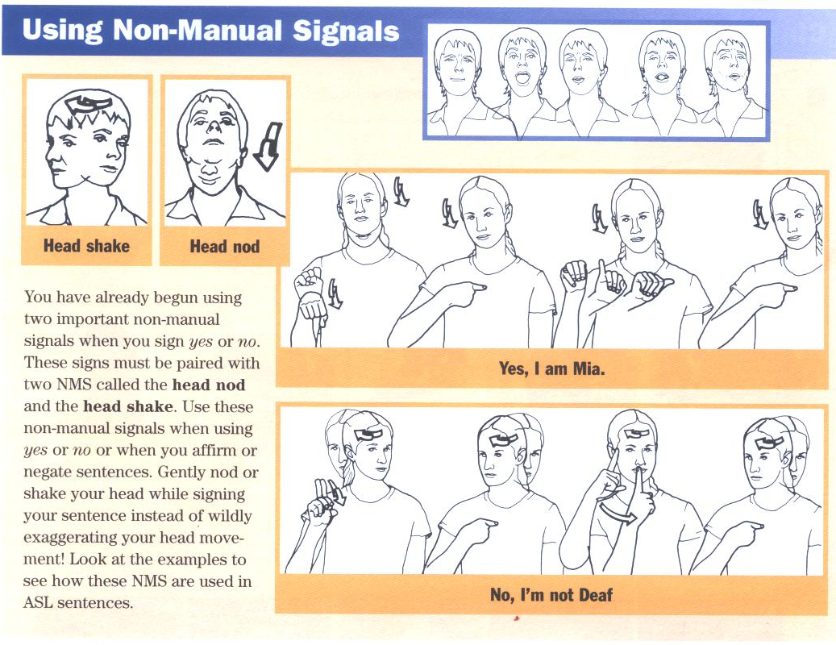

Slide 52
Using NMS (pg 28)
You have already begun using two important non-manual signals when you sign yes or no. These signs must be paired with two NMS called the head nod and the head shake.
Use these non-manual signals when using yes or no or when you affirm or negate sentences. Gently nod or shake your head while signing your sentence instead wildly exaggerating your head movement.
Look at the examples on page 28 to see how these NMS are used in ASL Sentences.

Slide 53
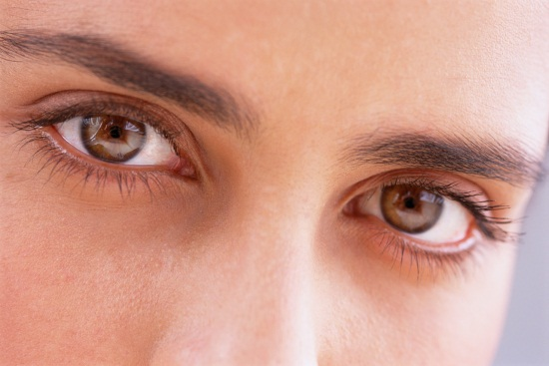
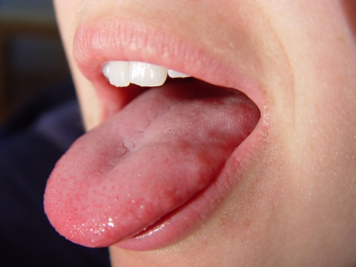
Non Manual Signals pg. 25
NMS – (Non Manual Signals) are the various parts to a sign that are not sign on the hand.
  ASL adverbs are made by the eyes and eyebrows.
  One important group of NMS is facial expressions.
ASL adjectives use the mouth, tongue and lips

Slide 54
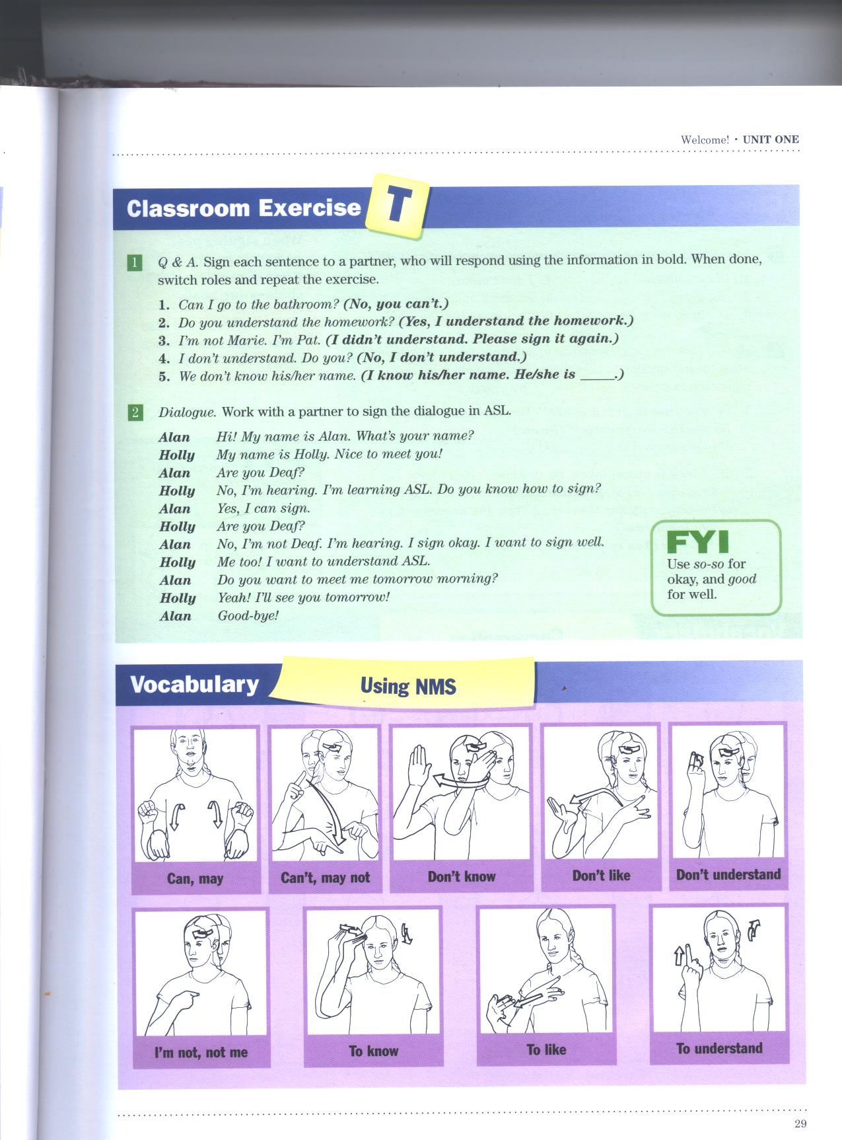

Slide 55
Using NMS Vocabulary pg. 29
Can, may
Can’t
To know
To like
To understand
Don’t know
Don’t like
Don’t understand
I’m not, not me

Slide 56
Signing with Facial Expressions pg. 26
BLANK FACE
BORED
EXCITED
FACIAL EXPRESSIONS
MAD, ANGRY
SAD
SICK, ILL
SCARED, AFRAID

Slide 57
Number time!
Let’s review the numbers and see how you do!
We are going to add on to the numbers…

Slide 58
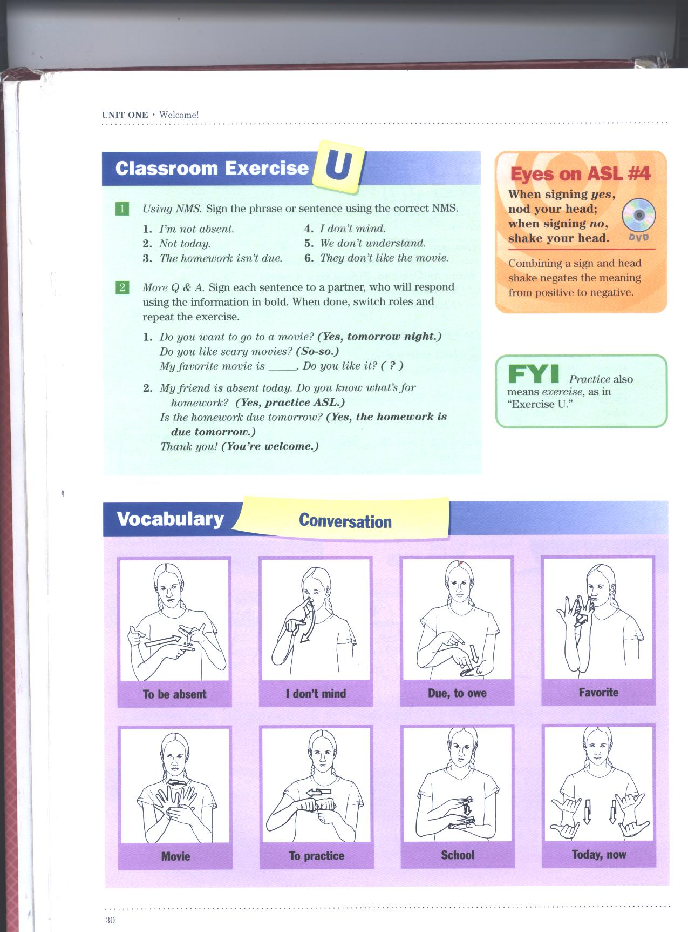

Slide 59
Conversation Vocabulary (p. 30)
ABSENT
DON’T-MIND
DUE, OWE
FAVORITE, PREFER, TASTE
MOVIE
PRACTICE
SCHOOL
TODAY, NOW

Slide 60
Using NMS, sign the phrase.
He’s not absent.
Not today.
The homework isn’t due.
I don’t mind.
We don’t understand.
They don’t like the movie.

Slide 61
Focus: “How do people learn American Sign Language?” pg. 22-23
Look at the handout of pages 22 & 23….
  READ SILENTLY

Slide 62
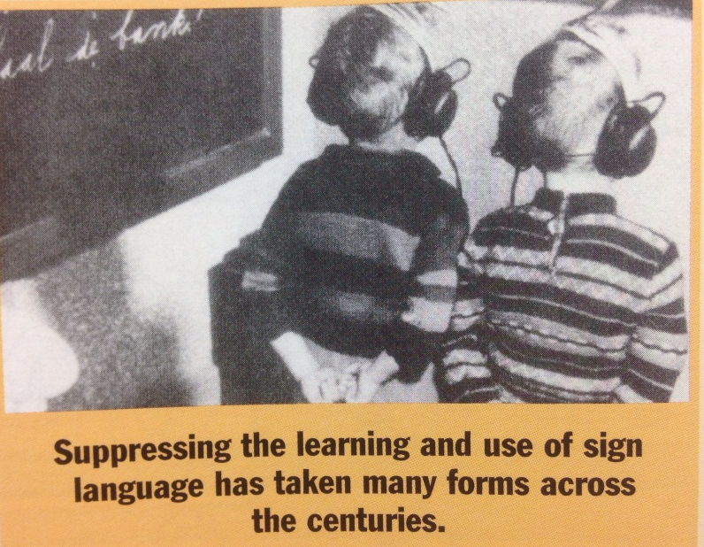
Main Points:
Majority of Deaf are raised in hearing families.
  10% of Deaf have Deaf parents
Often the use of sign language was forbidden, but because it is a NATURAL & INTUITIVE language, it couldn’t be suppressed.
Many older Deaf have multiple stories of only being allowed to sign when not in class or school.

Slide 63
Main Points Cont’d…
1960s- ASL gained recognition as a unique language from English.
1970s- Schools started using ASL to teach Deaf children
1980s- Deaf community started being recognized as a cultural minority rather than a disabled group of people.
1988- Deaf President Now
1990s- ASL became the fasted growing language offered as a foreign language... & IT KEEPS GOING!

Slide 64
What is the best way to learn a language?
IMMERSE YOURSELF! It’s sink or swim.
Make Deaf friends and attend Deaf events.
You will quickly realize there is a “Deaf World”
Be open-minded and take an interest.
You will get out the language, what you put in.

Slide 65
Pg 23.
As a student of ASL, keep this in mind:
  Need to recognize and accept that ASL in NOT ENGLISH.
    ASL has it’s own syntax (word order), grammar, nuances, etc. that are designed for the eye, not the ears like hearing people are used to.
    ASL makes visual sense.
  One word in English can have many separate signs in ASL, depending on the concept (meaning). It’s all about the meaning…
  FOR EXAMPLE…

Slide 66
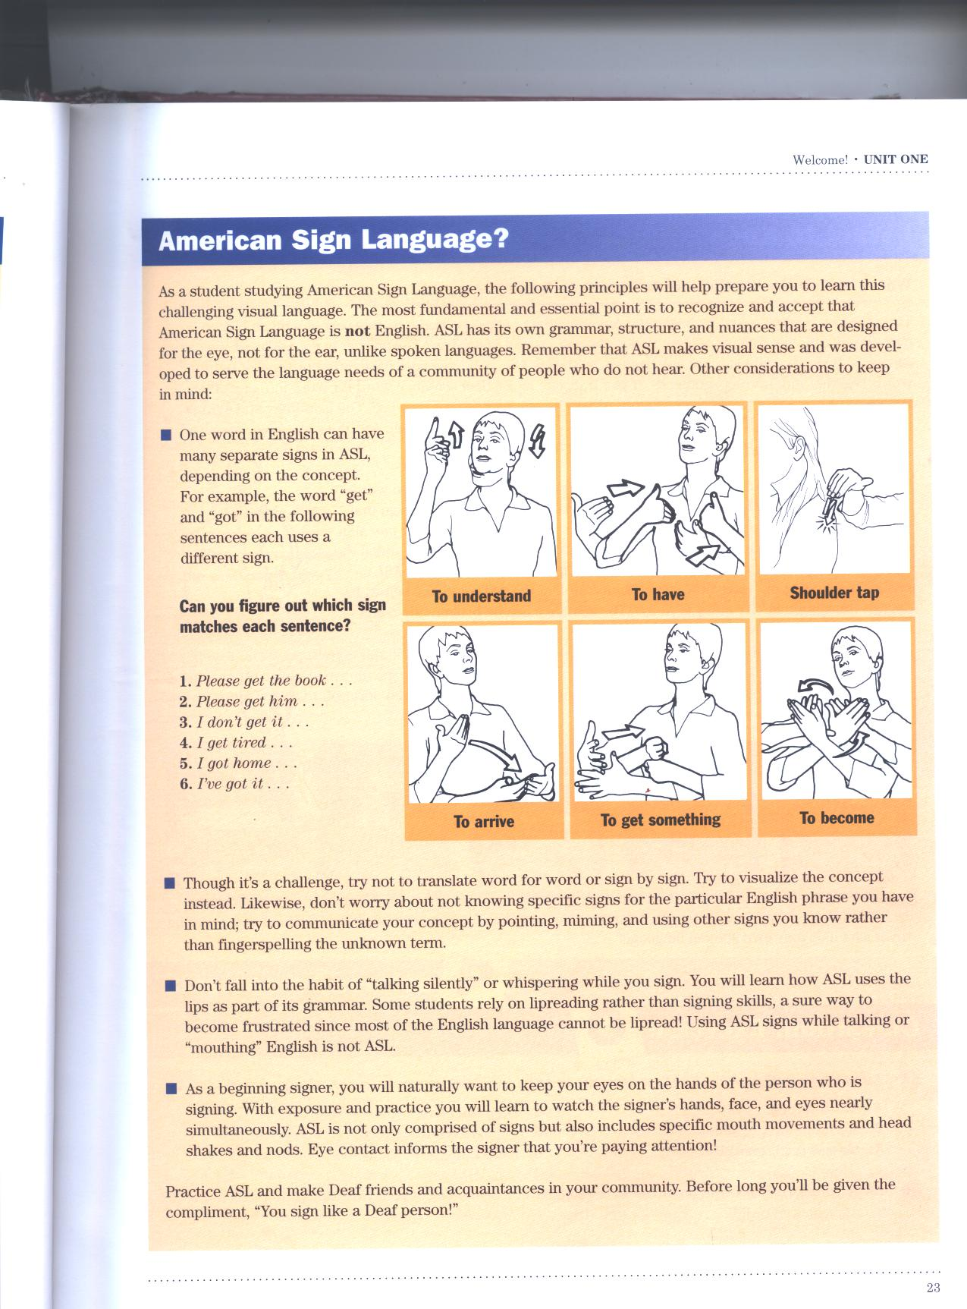
Which sign would you use?
TO GET

Slide 67
Pg. 23 continued
Don’t translate word for word. Think of the concept behind it. What is it really trying to say?
Don’t “talk” silently while signing. It takes away from the visual aspect.
  If you can mouth what you are saying while signing, and it makes sense, IT IS NOT ASL.
Don’t focus on the other person’s hands. Learn to make eye contact, and you will see everything else with it.

Slide 68
Where are the “little” words like is, to, and are? Pg 24.
Often asked, but it’s part of a bigger question: “Is ASL like English, except that it’s signed instead of spoken?”
  NO!
All languages have different ways of putting words together into correct sentences.
If you translate ASL signs, or any other language in English word for word it won’t make sense.
ASL does not need separate “little” words because they are already included in the sign.
  Example: Thank you.

Slide 69
Page 24 continued…
For example: Thank you.
  English requires the verb “to thank” and the object “you”
  ASL uses one sign to incorporate both the verb and the object.
Adding in these words could cause it to not make sense, or to look funny. “Thank you you”
It is important to learn how to use the language properly. Respect the language, event if it’s not yours.

Slide 70
Accent Steps (pg 28)
You don’t need a separate sign for don’t and not. Just use the head shake while signing the sentence.

Slide 71
Time + Topic + Comment
I will be absent tomorrow.
I don’t have practice today.
My favorite class is ________.
What is your favorite movie?

Slide 72
Sign practice using NMS…
They don’t know my name.
He isn’t paying attention.
HE PAY-ATTENTION HE.
I like learning ASL.
I LIKE LEARN ASL I.

Slide 73
Using NMS (pg 28)
English
ASL - GLOSS
Yes, I am Mia.
No, I’m not Deaf.
They aren’t sick.
I didn’t go to the bathroom.
Yes, I’m learning how to sign.
YES I M-I-A I
NO I DEAF I
THEY NOT-SICK
I NOT-GO-TO BATHROOM
YES, I LEARN SIGN I

Slide 74
Let’s review and learn some NUMBERS! 21 - 30
Numbers 21 – 30 are some of the most mixed up numbers in ASL. They not hard, just “different” than most of the others.
If you can sign from 1 – 30, everything else is EASY!!!
Count to 20 with me, then I will show you 21 – 30!

Slide 75
Partner Practice…
They don’t know my name. (Yes, they do.)
He isn’t paying attention. (No, he isn’t He doesn’t have eye contact.)
Are you sick? (No, I’m not.)
I like learning ASL. (Me too.)
We’re very busy today! (Yes, a lot of practice!)

Slide 76
Partner Practice
Find a partner and practice!
  Classroom Exercise “T” p. 29 #1
  Classroom Exercise “U” p. 30 #2
        KEEP PRACTICING, SWITCH ROLES, TAKE TURNS..UNTIL I SAY “STOP”!

Slide 77
WE HAVE FINISHED UNIT 1!!!
We will begin Unit 2, but you still have a test (on scantron) for Unit 1. We will take that test on Thursday!!!

Slide 78
Goodbye
Late
Me too, same here
To see, to see you
See you later
See you tomorrow
Take care
Tomorrow
Blank face
To be bored
To be excited
Facial expressions
To be mad, angry
To be sad
To be sick
To be scared, afraid
Can, may
Can’t, may not
Don’t know
Don’t like
Don’t understand
Understand
I’m not, not me
To know
To like
To be absent
I don’t mind,
  Do you mind?
Due, owe
Favorite
Movie
Practice
School
Today, now

Slide 79
Review of all Unit 1 signs!!!
Absent
Afternoon
Again, repeat
American sign language
Bathroom
Blank face
Bored
Busy
Can, may
Can’t, may not
Confused
Deaf
Don’t like
Don’t understand
Due, owe
Evening, night
Excited
Eye contact
Facial expressions
Favorite
Fine
Focus, pay attention
Friend
Go-to
Good, well
Good-bye
Happy
Hard of hearing

Slide 80
Review of all Unit 1 signs!!!
He, she, it
Hearing
Hello
Hold on
Homework
I am, me
I don’t mind
Introduce
Know
Last
Later
Learn
Like
Look at me
Mad, angry
Me too, same here
Meet
Morning
Movie
My
Name
Nice
No
No eye contact
Nothing, not much
Please
Practice
Sad

Slide 81
Review of all Unit 1 signs!!!
Same old, the usual
Scared, afraid
School
See
Sick
Sign, sign language
Sleepy
Slow, to slow down
Tomorrow
Turn off voice
Understand
Want
We are, us
What’s up
So-so
Take care
Thank you
They
Tired
Today, now

Slide 82
Review Unit 1!!!
Count to 30 using your ASL numbers.
What is a Deixis?
  Using the index finger to point to a person or object.
What is a closing signal?
  Using the Deixis at the end of the sentence.
How do you get a Deaf person’s attention?
  Tap their shoulder, wave your hand

Slide 83
Review Unit 1!!!
When hearing and Deaf people are present, it is considered rude if you don’t ______.
  Sign
What is the Question Maker?
  Raising of your eye brows indicating you’re asking a YES or NO question
What is Eye Gaze?
  Looking towards the area you are pointing to when using Deixis.

Slide 84
Review Unit 1!!!
What does NMS stand for?
  Non-Manual Signals
What are Non-Manual Signals?
  The various parts to a sign that are not signed on the hands. (Ex. Facial expressions)
ASL Adverbs are made by your…
  Eyes and eyebrows

Slide 85
Review Unit 1!!!
ASL Adjectives are made by your…
  Mouth, tongue, and lips
What are facial expressions?
  Convey the tone of your “voice” while you sign, show how you are feeling
What are two NMS that you already use?
  The head nod (yes) and head shake (no)

Slide 86
Conversation Practice
Stand next to someone you don’t know very well.

Slide 87
Get out a piece of paper…
On your paper, write down three questions for your partner, using vocabulary you have learned so far.
Sign the question to your partner using ASL, and write down their answer.
  You may only sign each question 2 times.
***If you don’t understand, ask them to repeat the question.

